Slide 1
Graphics of ML4Food
Doriela Grabocka

Slide 2
1. Overview of ML for Food Sciences
Tutorial 1 – Slides with *, the image is used in the corresponding section in the Jupyter notebook

Slide 3
What is Machine Learning? – the machine learning model
Machine Learning Model
Input
Predicted Output
Training data
ML Algorithm
ML Model

Slide 4
What is Machine Learning? – the machine learning model
Testing Phase
fed into
preprocessing
Testing data
Raw Data
Data
after learning
ML Model
ML Model
Predicted Output
Training data
fed into
Data Pre-Processing Phase
Learning Phase

Slide 5

What is Machine Learning? – the machine learning model*
1) PROCESS
2) TRAIN
Raw Data
Processed Data
Training data
insights about data
preprocessing
split
after learning
ML Model
3) EVALUATE
Testing data
Predicted Output
predictions

Slide 6
What is data?
n features
Sample no. | Feature 1 | Feature 2 | ……. | Feature n
1
2
3
…
m
m samples

Slide 7
Supervised Learning – Regression and classification
Supervised learning for regression and classification
Testing Phase
fed into
preprocessing
Testing data
Raw Data
Data
after learning
ML Model
ML Model
Predicted Output
Training data
fed into
Value
Category
Data Pre-Processing Phase
Learning Phase

Slide 8
Train-Test split
Train-Test split
Testing Phase
fed into
preprocessing
Testing data
Raw Data
Data
after learning
ML Model
ML Model
Predicted Output
Training data
fed into
Data Pre-Processing Phase
Learning Phase

Slide 9



Supervised Learning
Regression
Testing
New Sample
Training
Feature 1 | Feature 2 | … | Output
Sample 1 |  |  | 12
Sample 2 |  |  | 64
… |  |  | …
Sample m |  |  | 44
Learning phase
Model
Predict
Value

Slide 10
Supervised Learning - Classification
Classification
Testing
New Sample
Training
Feature 1 | Feature 2 | … | Output
Sample 1 |  |  | A
Sample 2 |  |  | B
… |  |  | …
Sample m |  |  | A
Learning phase
Model
Predict
Category

Slide 11



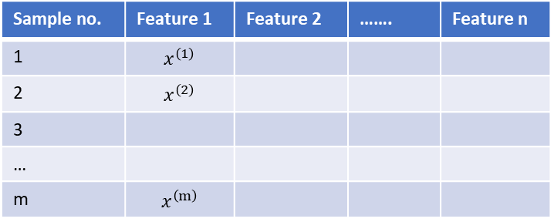



Standardization*
n features
Feature 1
Sample no. | Feature 1 | Feature 2 | ……. | Feature n
1 | $$x^{\left(1\right)}$$
2 | $$x^{\left(2\right)}$$
3
…
m | $$x^{\left(m\right)}$$
$$x_{s}^{\left(1\right)}=\frac{x^{\left(1\right)}−μ}{σ}$$
$$x_{s}^{\left(2\right)}=\frac{x^{\left(2\right)}−μ}{σ}$$
m samples
$$x_{s}^{\left(m\right)}=\frac{x^{\left(m\right)}−μ}{σ}$$
Find mean of column values μ
Find standard deviation of column values σ
Apply formula to all rows

Slide 12
Counting missing values
n features
Rows with nan
1
1
1
0
1
Sample no. | Feature 1 | Feature 2 | ……. | Feature n
1 | 1 | nan | 5 | 2
2 | nan | 2 | 3 | 4
3 | 7 | nan | nan | 5
… | 4 | 1 | 5 | 3
m | 1 | 2 | nan | 1
m samples
Columns with nans | 1 | 1 | 1 | 0

Slide 13
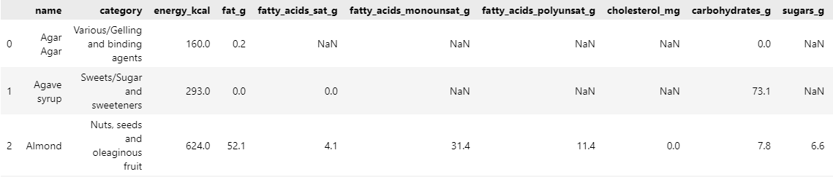
Counting missing values
n features
Rows with nan
1
1
0
samples
Columns with nans | 0 | 0 | 0 | 0 | 1 | 1 | 1 | 1 | 0 | 1

Slide 14
Counting missing values*
n features
ID | name | category | energy_kcal | fat_g | fatty_acids_sat_g | fatty_acids_monounsat_g | fatty_acids_polyunsat_g
0 | Agar | other | 160 | 0.2 | NaN | NaN | NaN
1 | Agave syrup | sweets | 293.0 | 0.0 | 0.0 | NaN | NaN
2 | Almond | fruits | 624.0 | 4.1 | 4.1 | 31.4 | 11.4
nans per row
3
2
0
samples
dataset.isna()
ID | name | category | energy_kcal | fat_g | fatty_acids_sat_g | fatty_acids_monounsat_g | fatty_acids_polyunsat_g
0 | 0 | 0 | 0 | 0 | 1 | 1 | 1
1 | 0 | 0 | 0 | 0 | 0 | 1 | 1
2 | 0 | 0 | 0 | 0 | 0 | 0 | 0
sum(axis=1)
sum(axis=0)
nans per column | 0 | 0 | 0 | 0 | 1 | 2 | 2

Slide 15
Counting missing values
n features
nans per row
5
4
0
samples
sum(axis=1)
dataset.isna()
sum(axis=0)
sum(axis=0)
nans per column | 0 | 0 | 0 | 0 | 1 | 2 | 2 | 1 | 0 | 2
nans per column | 0 | 0 | 0 | 0 | 1 | 2 | 2 | 1 | 0 | 2

Slide 16
2. Supervised Learning ML for Food Sciences
Tutorial 2 – Slides with *, the image is used in the corresponding section in the Jupyter notebook

Slide 17
Supervised learning*
Supervised learning for regression and classification
1) PRE-PROCESS
2) TRAIN
insights about data
Raw Data
Processed Data
Training data
preprocessing
split
after learning
3) EVALUATE
ML Model
Testing data
Predicted Output
Value
Category
predictions

Slide 18

Regression*
y
y
The regression line: y=ax+b
Predicted value
y’
train
x
x’
x

Slide 19


Classification*
y
red sample
y
The boundary line: y=ax+b
green sample
train
y’
new sample classified as red
x
x
x’

Slide 20
Overfitting and Underfitting*
red sample
green sample
y
y
y
x
x
x
underfitting (6 misclassified samples)
good model (3 misclassified samples)
overfitting model (0 misclassified samples)

Slide 21
Confusion Matrix*
 |  | Actual Values
 |  | Positive | Negative
Predicted Values | Positive | True Positive | False Positive
 | Negative | False Negative | True Negative

Slide 22
Decision Trees - Regression*
num_ingredients>1
yes
no
num_ingredients>2
bean_origin==Venezuela
max_depth
yes
no
no
yes
bean_origin==Venezuela
bean_origin==Peru
cocoa_percent>70%
bean_origin==Other
rating = 3.5
rating = 2
rating = 4
rating = 1
rating = 5
rating = 4.5

Slide 23
Random Forest-Regression*
max_depth
num_ingredients>1
max_depth
yes
num_ingredients>1
no
yes
no
num_ingredients>2
bean_origin==Venezuela
num_ingredients>2
bean_origin==Venezuela
no
yes
no
yes
no
yes
no
yes
bean_origin==Venezuela
bean_origin==Peru
cocoa_percent>70%
bean_origin==Other
bean_origin==Other
bean_origin==Venezuela
cocoa_percent>50%
bean_origin==Peru
n_estimators
rating = 3.5
rating = 2
rating = 4
rating = 1
rating = 5
rating = 4.5
rating = 2
rating = 2
rating = 1.5
rating = 1
rating = 5
rating = 4.5
Tree 1
Tree n
aggregate predictions
predicted rating

Slide 24
Decision Trees - Classification*
f_1 > a
yes
no
f_2 > b
f_3 > c
max_depth
yes
no
no
yes
f_2 < c
f_3 < a
f_2 > a
f_1 < b
class 0
class 1
class 0
class 0
class 1
class 0

Slide 25
Random Forest-classification*
f_1 > a
f_1 > a
no
yes
no
yes
max_depth
max_depth
f_2 > b
f_3 > c
f_2 > b
f_3 > c
no
no
yes
no
yes
no
yes
yes
f_2 < c
f_3 < a
f_2 > a
f_1 < b
f_2 < c
f_3 < a
f_2 > a
f_1 < b
n_estimators
class 0
class 1
class 0
class 0
class 1
class 0
class 0
class 1
class 0
class 0
class 1
class 0
Tree 1
Tree n
aggregate predictions
predicted class

Slide 26
3. Unsupervised Learning ML for Food Sciences
Tutorial 3 – Slides with *, the image is used in the corresponding section in the Jupyter notebook

Slide 27
Unsupervised learning*
Unsupervised learning for dimensionality reduction
1) PROCESS
2) TRAIN
n features
n’ features
Raw Data
Processed Data
insights about data
LD* Data
Further usage:
Visualization
Supervised learning
…
preprocessing
ML Model
n >> n’
*LD=lower dimensional

Slide 28
Unsupervised Learning – Clustering and dimensionality reduction
Unsupervised learning for clustering and dimensionality reduction
Testing Phase
fed into
preprocessing
Testing data
Raw Data
Data
after learning
ML Model
ML Model
Output
Training data
fed into
Cluster number
Samples with less features
Data Pre-Processing Phase
Learning Phase

Slide 29
Unsupervised Learning – Clustering and dimensionality reduction (Old)
Unsupervised learning for clustering and dimensionality reduction
Testing Phase
fed into
Testing data
Data
after learning
ML Model
ML Model
Output
Training data
fed into
Cluster number
Samples with less features
Learning Phase

Slide 30


PCA*
Find directions of highest variance
Project data points into these directions
x₂
x₂
Spread in x₂ direction
PCA 2 direction
Spread in PCA 1 direction
Spread in PCA 2 direction
Spread in PCA 2 direction
x₁
x₁
PCA 1 direction
Spread in x₁ direction

Slide 31
4. Mini-Project

Slide 32
Pipeline Graphic
Machine Learning Pipeline without Dimensionality Reduction
Machine Learning Pipeline with Dimensionality Reduction
Read the data
Read the data
Train- Test split
Reduce data dimensionality
Train the model
Train- Test split
Evaluate the model
Train the model
Evaluate the model

Slide 33
Pipeline Graphic*
Machine Learning Pipeline without Dimensionality Reduction
Machine Learning Pipeline with Dimensionality Reduction
Read the data
Reduce data dimensionality
Train- Test split
Train the model
Evaluate the model

